Slide 1

DAYANANDA SAGAR COLLEGE OF ENGINEERING Department of Medical Electronics Engineering
Project Review Presentation
(19MD8ICPR2)
MISCARRIAGE PREDICTION USING BIG DATA ANALYTICS AND IOT
USN | Name
1DS20MD010 | HARSHITHA J N
1DS20MD029 | PRAKRUTHI H U
Under the guidance of
Dr. A R Aswatha,
Professor and Head
DEPARTMENT OF MEDICAL ELECTRONICS ENGINEERING
DAYANANDA SAGAR COLLEGE OF ENGINEERING

Slide 2
INSTITUTE VISION
To impart quality technical education with a focus on research and innovation, emphasizing on development of sustainable and inclusive technology for the benefit of society
INSTITUTE MISSION
To provide an environment that enhances creativity and innovation in pursuit of excellence To nurture teamwork in order to transform individuals as responsible leaders and entrepreneurs To train the students to the changing technical scenario and make them to understand the importance of sustainable and inclusive technologies

Slide 3
DEPARTMENT VISION
To develop an excellent center of progressive quality learning, applied & translational research through inventive collaborations and sustainable solutions to address healthcare related societal challenges
DEPARTMENT MISSION
By creating a conducive atmosphere for continuous learning through increased participation of students and faculty in various academic activities • By achieving needful and relevant healthcare solutions through quality education and research • By imparting education in the path of ethical and social responsibilities, to work effectively with diverse groups for the benefits of the society

Slide 4
PROGRAMME EDUCATION OBJECTIVES (PEOs)
Graduates will be able to:
PEO1 | Apply knowledge of Medical Electronics to excel in their profession
PEO2 | Practice Engineering to analyze problems and find solutions in allied domains using multidisciplinary approach
PEO3 | Disseminate professional skills for ethical and societal responsibilities
PEO4 | Engage in lifelong learning and contribute in the field of engineering research
PROGRAMME SPECIFIC OUTCOMES (PSOs)
PSO1 | Apply the knowledge of electronics for solving diverse problems of Medical Instrumentation
PSO2 | Analyze and implement different techniques in Medical Image and Signal Processing domains catering to Design, Research and Development
PSO3 | Provide sustainable solutions in health care and its allied fields by imbibing managerial and techno social values

Slide 5
COURSE OUTCOMES: After the completion of the course, the graduates will be able to
CO | Project Phase 2 - 19MD8ICPR2
CO1 | Apply fundamental concepts of engineering and review research literature to analyze solutions to healthcare problems
CO2 | Design solutions to healthcare problems by sustained critical investigation of research-based knowledge
CO3 | Select and apply appropriate tools and techniques for developing prototypes or algorithms for specific problems
CO4 | Assess the health, societal, environmental, safety and legal issues with illustrations of impact and responsibilities of engineering solutions in these contexts
CO5 | Develop professional communication skills and to function in a team to achieve objectives.

Slide 6
CONTENTS
PROBLEM STATEMENT
INTRODUCTION
OBJECTIVES
LITERATURE SURVEY
COMPONENTS WITH APPROXIMATE BUDGET
METHODOLOGY
RESULTS
DISCUSSION AND CONCLUSION
REFERENCES

Slide 7
PROBLEM STATEMENT
“By harnessing vast datasets and monitoring through IoT devices, this innovative system aims to proactively identify potential risk factors, enabling timely interventions and personalized care to mitigate the devastating impact of miscarriages, ultimately advancing maternal and fetal well-being”.

Slide 8
INTRODUCTION
Miscarriage, medically known as spontaneous abortion, refers to the natural loss of a pregnancy before the 20th week of gestation.
Predicting miscarriage is a complex task, and no model can guarantee absolute accuracy. However, leveraging big data analytics and IoT can contribute to early detection and intervention, potentially improving outcomes for pregnant women.
Figure : Different types of pregnancy complications

Slide 9
OBJECTIVES
To develop and implement a Machine Learning Algorithm(Random Forest) for miscarriage risk prediction.
To analyze extensive pregnancy-related data such as Heart Rate, Temperature, β HCG etc and the risk factors associated with it.
To validate the effectiveness and efficiency of the developed system through used Predictive model and to reach greater accuracy of the outcome.

Slide 10
LITERATURE SURVEY
Sl. No | Authors detail | Title | Publisher details | Inference
 | H. Asri and Z. Jarir | “Towards a smart health: Big data analytics and IoT for real-time miscarriage prediction” | Journal of Big Data, 2023, Volume 07, DOI-10.1186/s40537-023-00704-9 | The study leverages sensor, mobile phone, and patient-generated data, employing IoT technologies such as Raspberry Pi and K-means clustering algorithms within Databricks Spark to predict miscarriages. Validated through clustering techniques, the system provides doctors with proactive intervention results via a mobile app and offers personalized advice to pregnant women based on 15 real-time risk factors..
2. | Zheng Li, Ying-Dong He, Qian Chen | “A risk-prediction nomogram for patients with second-trimester threatened miscarriage associated with adverse outcomes” | Research Square Journals, November 2020. DOI-10.21203/rs.3.rs-111117/v1 | This paper collected information from the patients hospitalized with second-trimester threatened miscarriage and used the logistic regression analyzes to determine the most significant predictive factors associated with miscarriage.
3. | Hiba Asri, Hajar Mousannif, Hassan Al Moatassime | “Comprehensive miscarriage dataset for an early miscarriage prediction” | Elsevier Journals, 2019, Volume 04, DOI-10.1016/j.dib.2018.05.012 | The study improves a miscarriage prediction model by expanding the dataset to include 15 attributes, all directly related to real-time miscarriage risk factors. To enhance efficiency, the researchers streamline data collection by exclusively using Raspberry Pi, eliminating Arduino UNO.

Slide 11
4. | Asri H,Mousannif H, Moatassime H A and et.al | “Big data analytics in healthcare: case study - miscarriage prediction” | International Journal of Distributed Systems and Technologies, October-December 2018 Volume 10, DOI:-10.4018/IJDST.2019100104 | The study introduces a versatile disease prediction system that utilizes big data tools, machine learning algorithms, and IoT for accurate outcomes. Specifically applied to real-time miscarriage prediction using the K-means centroid-based algorithm, the system demonstrates its adaptability and effectiveness by categorizing outcomes into three groups: Miscarriage, No Miscarriage, and Probable Miscarriage.
5. | Nicole STAMATOPOULOS, Chuan LU, Ishwari CASIKAR, Shannon REID, Max MONGELLI, Nigel HARDY and George CONDOUS | “Prediction of subsequent miscarriage risk in women who present with a viable pregnancy at the first early pregnancy scan” | Australian and New Zealand Journal of Obstetrics and Gynecology, 2017 Volume08, DOI-10.1111/ajo.12395 | In this paper they developed a new prediction model which indicates the likelihood of miscarriage. In women who present with a viable IUP at the primary scan, advancing maternal age in the presence of clots PV increases the probability of subsequent miscarriage.

Slide 12
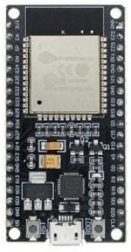
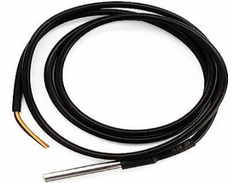
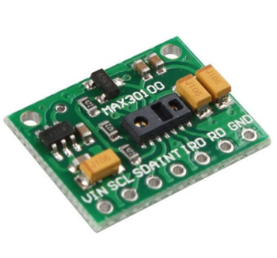


COMPONENTS WITH APPROXIMATE BUDGET
COMPONENTS | BUDGET in Rs
ESP32 Microcontroller | 454/-
One Wire Temperature Sensor | 149/-
SPO2 Sensor (MAX30100) | 113/-
Alcohol Sensor(MQ3) | 163/-
Gas Sensor(MQ2) | 199/-
Resistors | 40/-
Data Set | 3000-5000/-
Miscellaneous | 1000/-
 | 6000-7000/-
One Wire Temperature Sensor
ESP32 Microcontroller
SPO2 Sensor(MAX30100)
Gas/Alcohol Sensor
Resistors

Slide 13
METHODOLOGY
Dataset Gathering
ESP 32
Microcontroller
Temperature
Analyze and Preprocess Dataset
Heart Rate/SpO2
Feature Engineering
Splitting dataset
Train Test
User I/P
IoT
Communication
ML Training
Storing Model
Cloud
GET I/P
From user and Cloud
MISCARRIAGE PREDICTION
Figure : Block Diagram of Miscarriage Prediction System

Slide 14
Contd.
Data Collection: Gathering diverse datasets and physiological data using IoT sensors.
Data Preprocessing: Cleansing, normalizing, and handling missing values and outliers in the data.
Feature Engineering: Selecting relevant features and creating new informative ones to enhance model performance.
Model Development: Implementing machine learning algorithms and optimizing their performance.
Model Evaluation: Assessing model performance using various metrics and ensuring generalization through cross-validation.
IoT Integration: Developing protocols for interfacing with IoT sensors and integrating data streams with predictive models.
User Interface Design: Designing an intuitive interface for visualizing predictions and monitoring maternal health parameters.
System Integration and Testing: Integrating software components with IoT hardware and conducting thorough testing.
Deployment and Validation: Deploying the system for real-world testing, collaborating with healthcare professionals, and collecting feedback for improvement.

Slide 15
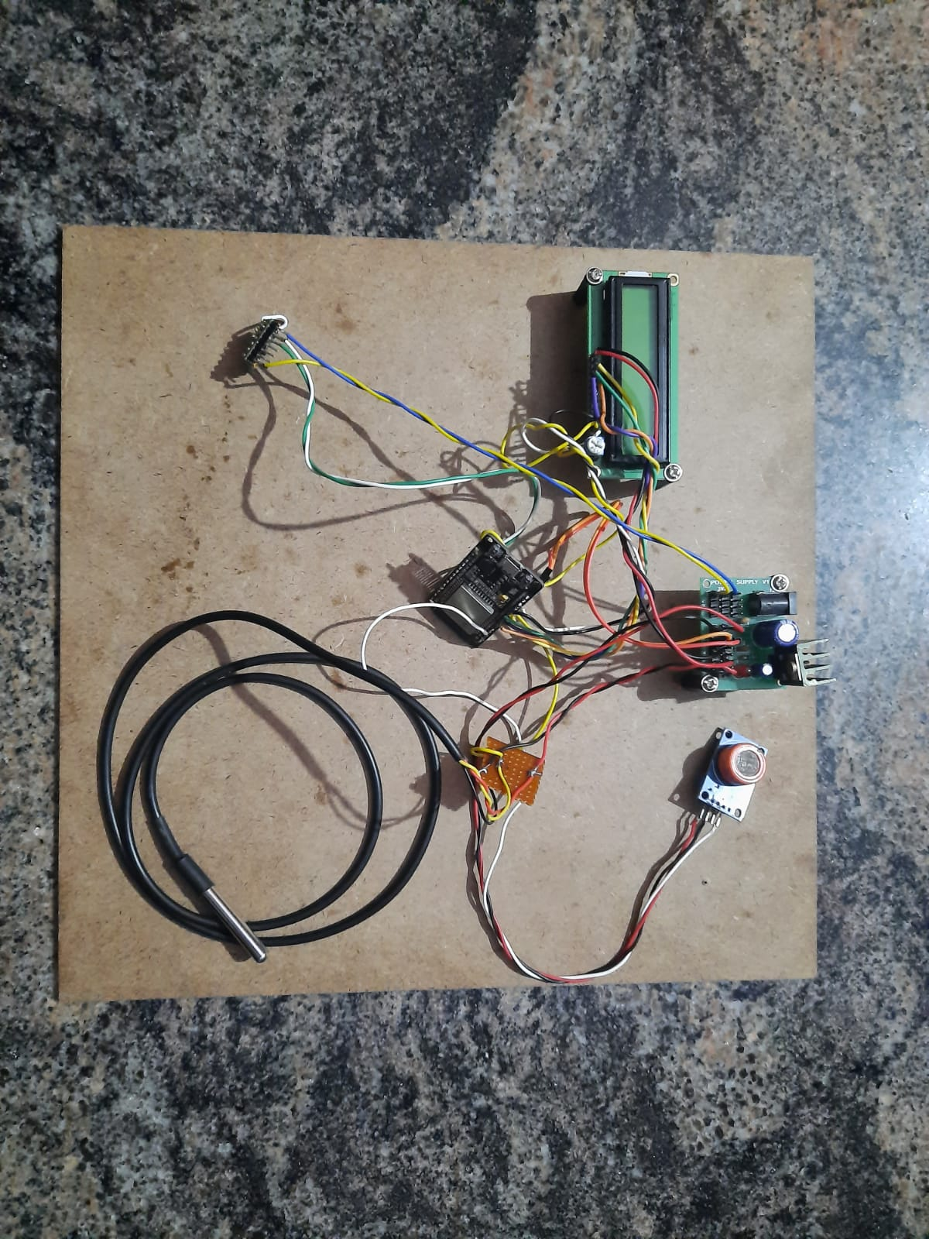
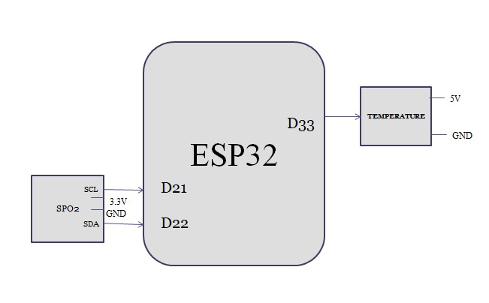
RESULTS
Gas Sensor
LED Display
Gas Sensor
ESP 32
Temperature sensor
SpO2 Sensor
Figure: Hardware circuit diagram
Figure: Hardware Circuit Connection

Slide 16
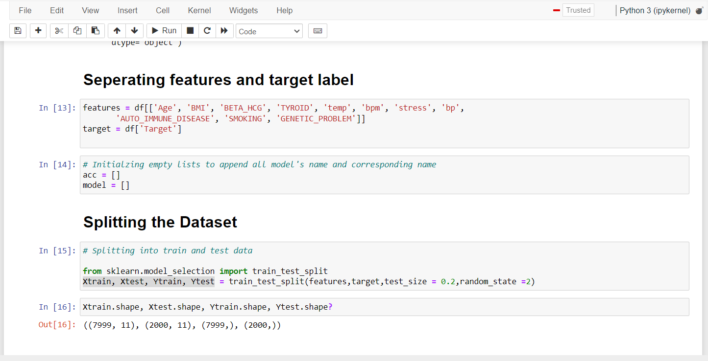
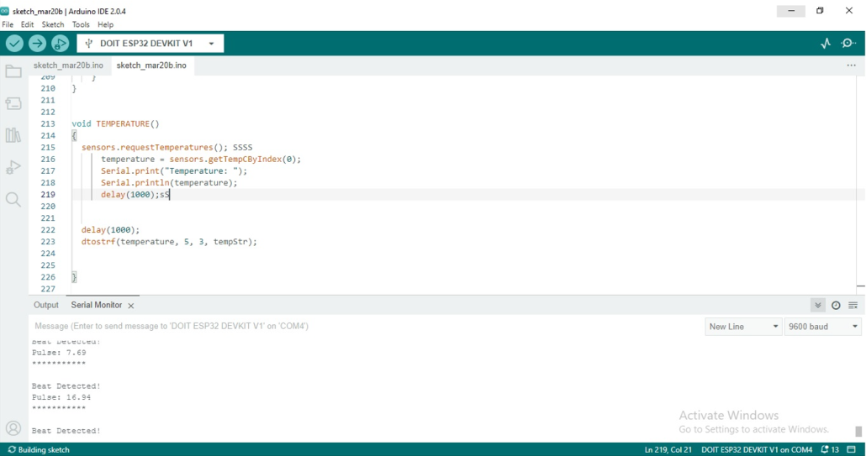
Contd.
Figure: Software code
Figure : Arduino IDE code

Slide 17
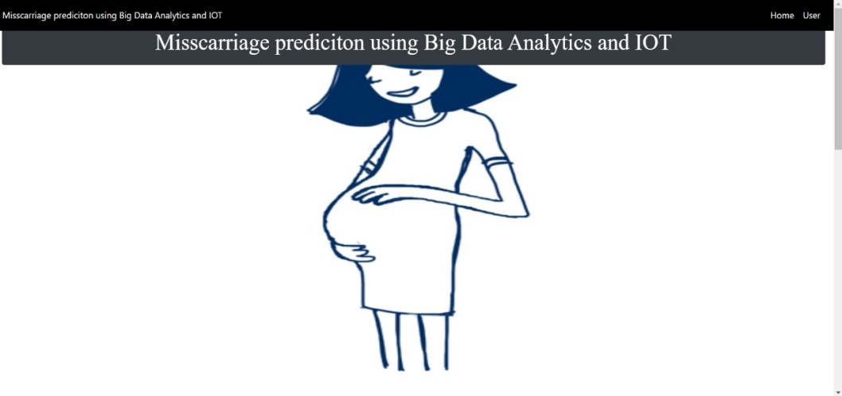
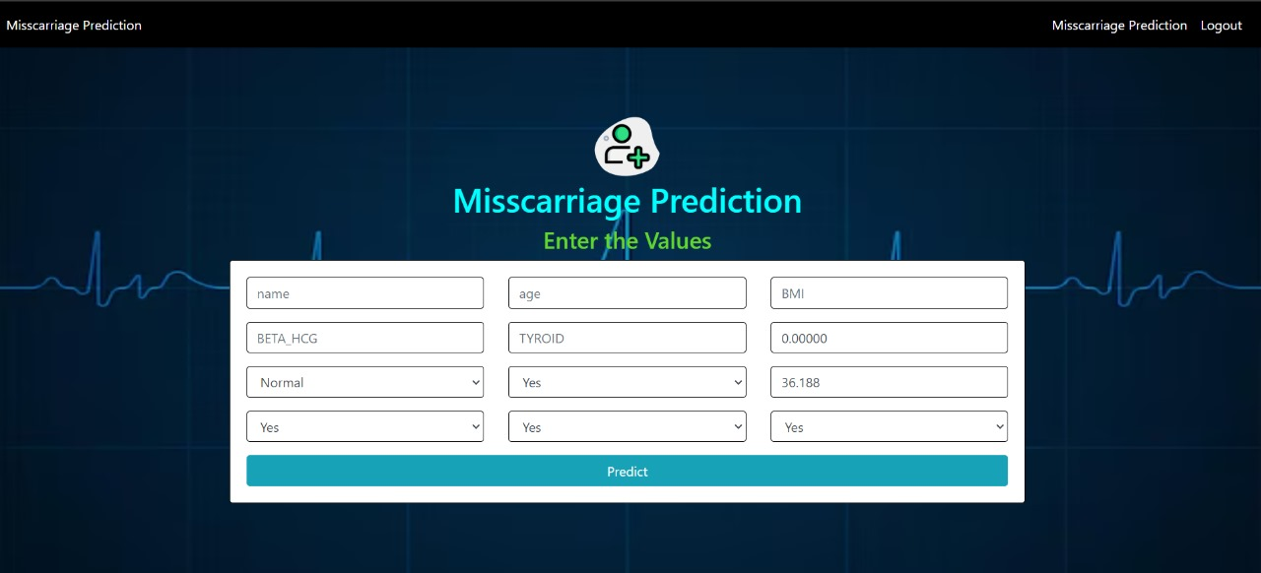
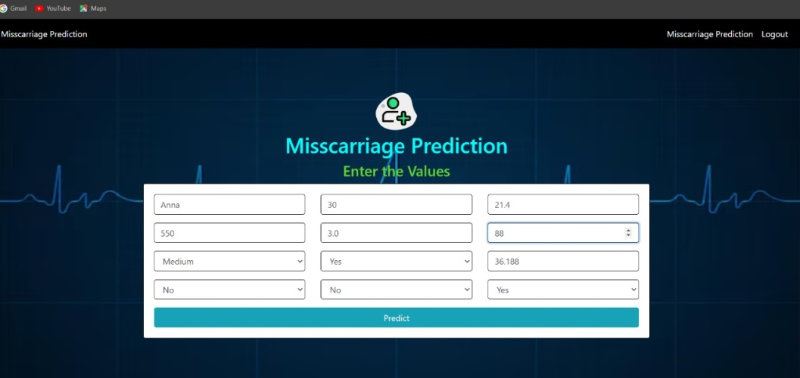
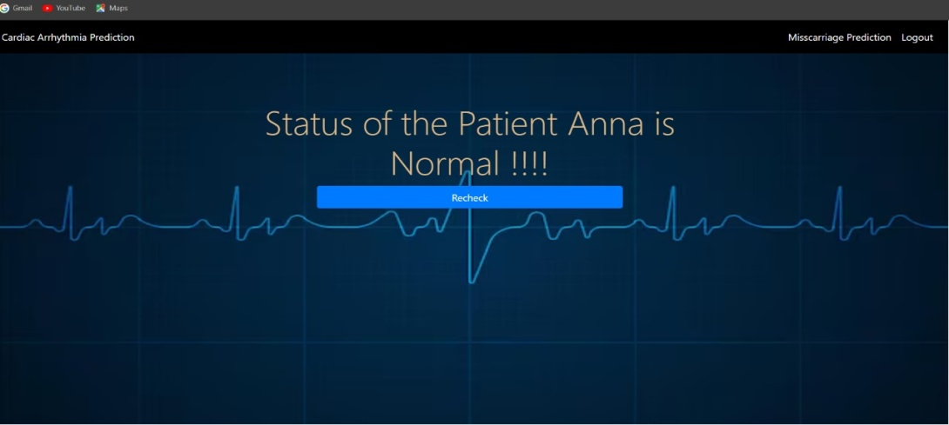
Contd.
Figure: Website page of the miscarriage system
Figure: Patient details Entry
Figure: After the Patient detail entry
Figure: Result obtained after analysing the data

Slide 18
Contd.
By the risk factors gathered from sensors, reaction is taken in advance and complications are tracked.
Development of a predictive model combining machine learning and IoT technology to identify individuals at risk of miscarriage.
To gather extensive pregnancy-related data, including maternal health and various risk factors associated with miscarriage.

Slide 19
DISCUSSION and CONCLUSION
Integrating IoT sensors with predictive model provides time monitoring and analysis, enabling early detection of potential complications
Collaborating with healthcare professionals and gathering feedback during deployment ensures continuous enhancement and adaptation to maternal health care needs.
To assess the efficacy and efficiency of the implemented Predictive model and enhance outcome accuracy, rigorous validation procedures are employed, ensuring robust evaluation of the system's performance.

Slide 20
REFERENCES
[1] H. Asri and Z. Jarir,“Towards a Smart Health: Big Data Analytics and IoT for Real-Time Miscarriage Prediction”, Journal of Big Data, 2023, Volume 07, DOI-10.1186/s40537-023-00704-9.
[2] Zheng Li, Ying-Dong He, Qian Chen, “A Risk-Prediction Nomogram for Patients with Second-Trimester Threatened Miscarriage Associated with Adverse Outcomes”,Research Square Journals, November 2020. DOI-10.21203/rs.3.rs-111117/v1.
[3]Hiba Asri,Hajar Mousannif, Hassan A.Moatassime “Comprehensive Miscarriage Dataset for an Early Miscarriage Prediction”,Elsevier Journals, 2018, Volume 04, DOI-10.1016/j.dib.2018.05.012.
[4] Asri H,Mousannif H, Moatassime H A and et.al“Big Data Analytics in Healthcare: Case Study - Miscarriage Prediction”International Journal of Distributed Systems and Technologies, October-December 2019, Volume 10, DOI:-10.4018/IJDST.2019100104.
[5]Nicole STAMATOPOULOS, Chuan LU,Ishwari CASIKAR, Shannon REID, Max MONGELLI, Nigel HARDY and George CONDOUS “Prediction of Subsequent Miscarriage Risk in Women who Present with a Viable Pregnancy at the First Early Pregnancy Scan”,Australian and New Zealand Journal of Obstetrics and Gynecology, 2015 Volume08, DOI-10.1111/ajo.12395.

Slide 21
THANK YOU

